Slide 1
ABAP Part I
Lesson 04: Selection Screen

Slide 2
Lesson Objectives
After completing this lesson, participants will be able to understand -
Learn to create a selection screen

Slide 3
Defining Selection Screens
There are three ABAP statements for defining selection screens:
PARAMETERS for single fields
SELECT-OPTIONS for complex selections
SELECTION-SCREEN for formatting the selection screen and defining user-specific selection screens
The selection screen that is defined using PARAMETERS or SELECT-OPTIONS statements on their own, has a standard layout in which all parameters appear line by line.
This layout is not always sufficient.
For example, when you define a group of radio buttons, you should set off these buttons against other input fields so that the user can identify them as a group.
Notes:
When defining input screens for the use of reporting on data, various selection elements can be combined to maintain data integrity and still be easy to use.
These elements include standard input fields such as selection options and parameters, as well as others such as check boxes, radio buttons, and pushbuttons all arranged on a selection screen

Slide 4
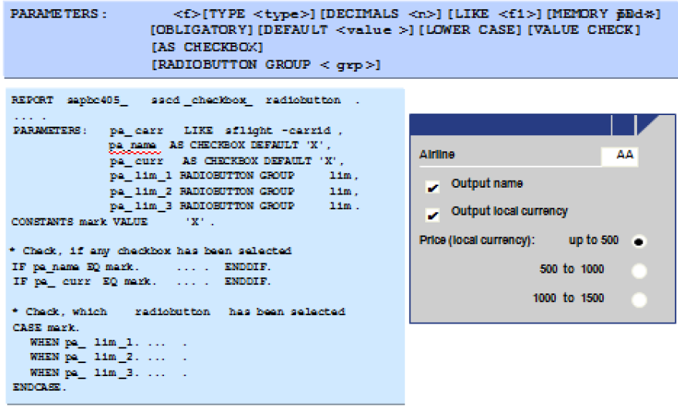
Selection Screen: Declaring Fields with Parameters

Slide 5
PARAMETERS Statement
A parameter is a special type of variable that is defined using the parameters statement.
Parameters is a lot like the data statement, but when you run the program, the system will display the parameters as input fields on a selection screen before the program actually begins to execute.
The rules for parameters names are the same as for variables names, except for the following:
The maximum length is 8 characters instead of 30.
You can assign the initial value of a parameter using the parameter default.

Slide 6
Syntax for PARAMETERS Statement
The following code is the syntax for defining a variable using the parameters statement.
parameters p1[ (l) ] [type t] [decimals d]
Or
parameters p1 like v1
[default ‘xxx’] [obligatory] [lower case] [as check box]
[radiobutton group g]
Notes:
Where:
p1 is the parameter name
v1 is the name of a previously defined variable or parameter, or is the name of a field that belongs to a table or structure in the Data Dictionary
(l) is the internal length specification
t is the data type
d is the number of decimal places (used only with type p)
‘xxx’ is a literal or previously defined variable that supplies
a default value

Slide 7
Example
parameters p1(2) type c.
parameters p2 like p1.
parameters max_value type i default 100.
parameters cur_date type d default ‘20030827’ obligatory.
parameters cur_date Like sy-datum default sy-datum obligatory.

Slide 8
Example
You declare parameters in the PARAMETERS statement analogous to report internal fields:
PARAMETERS: NAME(30) OBLIGATORY DEFAULT ‘Renu ’,
AGE(2) TYPE P.
You assign the initial value of a parameter using the parameter DEFAULT.
The parameters statement can not be used for type f .

Slide 9
Additions to Parameter statement
Addition
Use
Type
Same as the data
decimals
Same as the data
Like
Same as the data
default
Same as the value addition on the data statement
obligatory
The user must enter a value into the field before the program will execute
lower case
Prevents values from being translated to uppercase
as checkbox
Displays the input field as check box
Radio button group g
Displays the input field as a radio button belonging to group g

Slide 10
Additions to Parameter statement
Using the Addition : Lower Case
All values entered into a parameter are translated into uppercase by default. To turn off this translation, use the addition lower case.
This translation applies only to character fields.
Using the Addition : Check Box
A checkbox has two states: ticked and clear.
You use them when you want to present the user with an on/off or true or false type of choice.
You can use more than one checkbox on a screen.
E.g. parameters: cb1 as checkbox default ‘X’,
cb2 as checkbox,

Slide 11
Additions to Parameter statement
Using the Addition : radiobutton group
Like check boxes, a radio button also has two states: selected and not selected.
Unlike check boxes, radio buttons never operate alone; they operate in groups.
You can have any number of radio buttons in a group (greater than 1), but only one can be selected at a time.
They are used when you need to present the user with a list of alternatives in which only one option can be chosen
To display a parameter as a radio button, use the addition radiobutton group g.
E.g. parameters: rb1 radiobutton group g1 default ‘X’,
rb2 radiobutton group g1,
rb3 radiobutton group g1.
Notes:
To display a parameter as a radio button, use the addition radiobutton group g. You cannot specify a data type or length; it will default to type c and length 1. g is an arbitrary group name one to four characters long. You can have more than one group in a program. The parameter will contain a capital X, if the radio button is selected; it will contain a blank if not selected. To be initially selected, the radio button should contain a default value of capital X. No other values are valid for a radio button. E

Slide 12
Parameter Fields
Parameter Input Field Labels
On the selection screen to the left of each parameter’s input field is a label.
By default, the label is the same as the name of the parameter.
You can set these labels manually.
For parameters defined like Data Dictionary fields, you can retrieve the label automatically from the data element.
Changing Parameter Labels
You can change the labels for the parameters appearing on the selection screen by using the text symbols.
Follow this path to change the text symbols.
(Menu bar –GOTO->TEXT ELEMENTS ->SELECTION TEXTS)

Slide 13
Demo
Program on using Parameters and its options

Slide 14
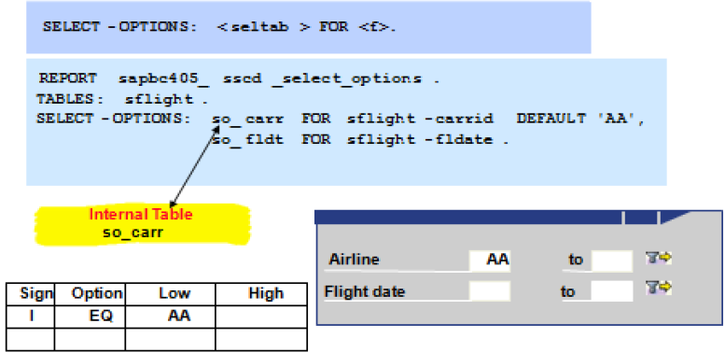
Selection Screen: Declaring Fields with Select-Options
OBLIGATORY generates a mandatory field.
NO-EXTENSION suppresses multiple single or multiple range selections.
NO INTERVALS suppresses the SELTAB-HIGH (upper interval limit) entry on the selection screen.

Slide 15
Demo
Program on using select-options

Slide 16
Summary
In this lesson, you have learnt:
How to create a selection screen

Slide 17
Review Question
1. Selection screen elements can be combined into cohesive units called ____.
2. The default selection screen has the number ____.

